Slide 1
VVF INDIA LTD
HYDROGEN PEROXIDE (H2O2) PRE-FEASIBILITY REPORT

Slide 2
Why H2O2

Slide 3
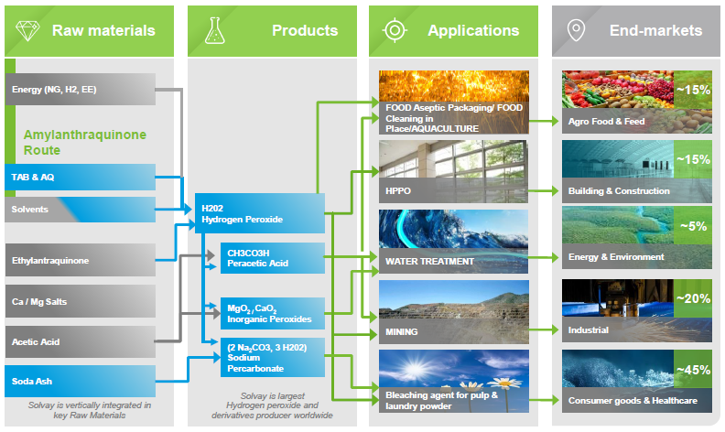
H2O2 Key Transformation process

Slide 4
Indian Market Demand-supply scenario
Current GACL ongoing Expansion of H2O2 14400MTA
Still gap found 9228MTA

Slide 5
H2O2 Need for Indian Market
There are only four manufacturers in India .
1.Gujrat Alkalies and Chemicals Ltd.
2.National Peroxide Ltd
3.Asian Peroxide Ltd
4.Hindustan Organic Chemicals Ltd.

Slide 6
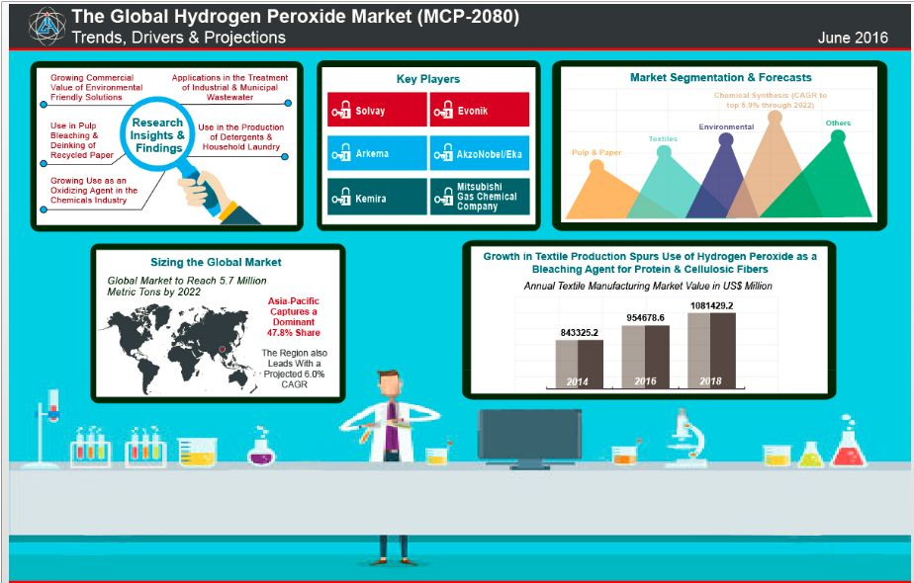
Global Market Trend

Slide 7
Forecast for the H2O2

Slide 8
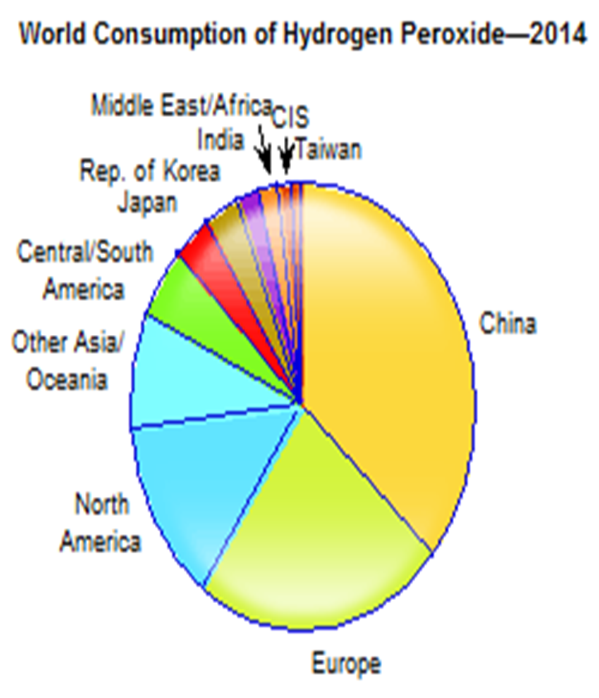
H2o2 Regional Consumption Report
Main end Market
1 Paper & Pulp industry - 55%
2 Chemical & laundry industry -33
Regional market Share
China - 40%
Europe – 19%
North America – 12%
Other Asia – 11%
Cen//S America - 4%
Japan – 4%
Rep of Korea – 3%
India – 3%
Middle east/Africa – 2%
CIS – 1%
Taiwan – 1%

Slide 9
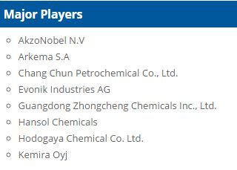
Competitive landscape
Total Companies Profiled 47
Region/ Country | Players
The United States | 9
Japan | 6
Europe | 9
Asia-Pacific (Excl. Japan) | 21
Latin America | 1
Middle East | 1

Slide 10
H₂O₂ Introduction
Hydrogen peroxide, a weakly acidic colorless liquid, was discovered by Thenard in 1818 and has been uses industrially since the mid-19th century. Its scale of manufacture and use have increased markedly since about 1925 when electrolytic processes were introduced to the United States and industrial bleach applications were developed. Now prepared primarily by anthraquinone autoxidation (where a molecule is oxidized by oxygen), hydrogen peroxide is used widely to prepare other peroxygen compounds and as a nonpolluting oxidizing agent.

Slide 11
Physical properties of H2O2
Property Value
melting point / degC -0.41
boiling point / degC 150.2
density at 25oC / g mL-1 1.4425
viscosity at 20oC / MPas 1.245
surface tension at 20oC / mNm-1 80.4
specific conductance at 25oC / Ω.cm 4 x 10-7
enthalpy of fusion / J g-1 367.52
specific heat at 25oC / J g-1 2.628
heat of vaporization at 25oC / J g-1 1517
pKa at 20degC 11.75
heat of dissociation / kJ mol-1 34.3

Slide 12
Raw material consumption/MT of H2O2
Sr.No. | Raw Material | Proposed Qty./MT of H2O2
1 | Hydrogen gas | 710-730 Nm3
2 | Ethy Anthra Quinone | 0.8-1 Kg
3 | Shellsol | 0.83-5 Kg
4 | Tetra Butyl Urea | 0.5-0.8 Kg
5 | Tetra octyl phosphate | 0.16 Kg
6 | Palladium catalyst | 0.02-0.04 Kg
7 | stabillizer | 0.4-0.8 Kg
8 | Nitric acid | 0.83 Kg
9 | Phospheric acid | 0.8-1 Kg
10 | Treated alumina | 9.5-12 Kg

Slide 13
Utility Consumption
Sr. No. | Entity | Qty./MT Of H2O2
1 | Raw Water | 0.5m3
2 | Steam | 1.7T@22 kg/cm2
3 | Compressed Air | 3394Nm3@ 3Kg/cm2
4 | Electricity | 0.7mwh

Slide 14
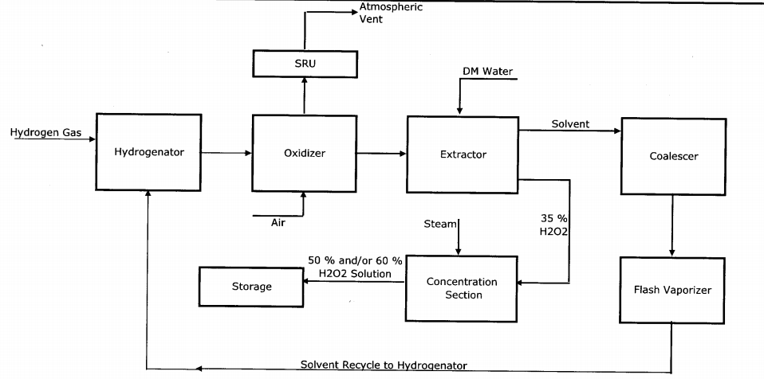
H2O2 process

Slide 15
H2O2 Process Reaction
NG Reforming- H2 ,CO2 & CO forming from NG
CH4+H2O= CO+3H2 CO+H2O=CO2+H2
Hydrogen Purification-H2 of 98.5 Purity obtain by PSA technology
CO2 & CO got removed
Hydrogenation-Enthraquinone solution is used under existence of Pd catalyst to produce hydrogenated enthraquinone.
H2+EAQ = EAQinol
Oxidation – Hydrogenated enthraquinone reacted with oxygen EAQinol + O2= H2O2 + EAQ
H2O2 Extraction - The deionized water extracts the H2O2 from oxidized solution

Slide 16
Profit Scenario
H2O2 Production Capacity – 10KTA
Saleable H2O2 Capacity(50% Concentration )– 20KTA
H2O2 sell Price -Rs30/Kg
Total Sale - 60 crores /Annum
Profit Booked @ 10% - 6Crores/Annum

Slide 17
10KTA H2O2 Plant – 80 Crores
NG – 10000 scm/day
Minimum NG Availability
H2- 1000 Nm3/ hr H2- 22800Nm3/Day
H2 production per Hour and Day
730Nm3 H2 required to produce per MT of H2O2
H2O2 Production – 31.23T/Day or 11KTA cap (100% basis) plant to be built
Saleable Qty. 50% grade = 22KTA

Slide 18
Cost Break-Up
Item | Cost (Rs in Crore)
1 Technology Licensing & FEED for H2O2 | 10
2 Engineering and Construction | 10
3 Resource and Infrastructure cost | 50
4 Contingency & Escalation | 5
5 Capitalized Interest | 5
Total cost | 80

Slide 19
Conclusion
The current demand Gap 9 KTA Vs our proposed plant 10 KTA capacity matched which also meet our excess NG utilization of 10000 SCM/ Day
THANK YOU

